Slide 1
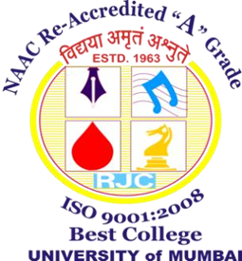
Name: Ms. Sujata Rahul Kotian
Qualification: BSc.IT, MSC.IT, Pursuing Ph.D in Information Technology
Subject: Research Methodology
“Intellectual growth should commence at birth and cease only at death.”
― Albert Einstein

Slide 2
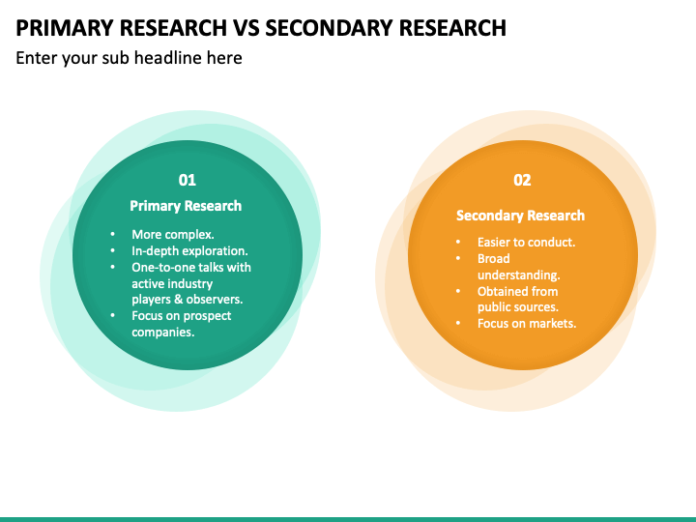

Slide 3
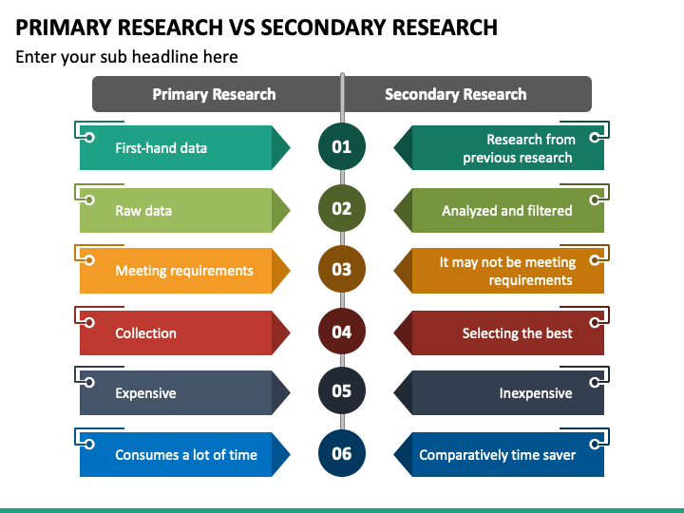

Slide 4
BASIS FOR COMPARISON | PRIMARY RESEARCH | SECONDARY RESEARCH
Meaning | Research conducted to gather first-hand information, for the current problem is called Primary Research. | Secondary Research is one that involves use of information gathered originally by primary research.
Based on | Raw data | Analysed and interpreted information
Carried on by | Researcher himself | Someone else
Data | Specific to the needs of researcher. | May or may not be specific to the needs of researcher.
Process | Very Involved | Rapid and Easy
Cost | High | Low
Time | Long | Short

Slide 5
https://researchmethod.net/research-problem/#:~:text=Types%20of%20Research%20Problems,-Types%20of%20Research&text=These%20problems%20involve%20describing%20or,gender%2C%20income%2C%20and%20education.

